Slide 1

Social Media Privacy Settings
How to make your profiles private on TWITTER
Angelica Gonzalez, Lupe Heredia, Malia Xiong

Slide 2

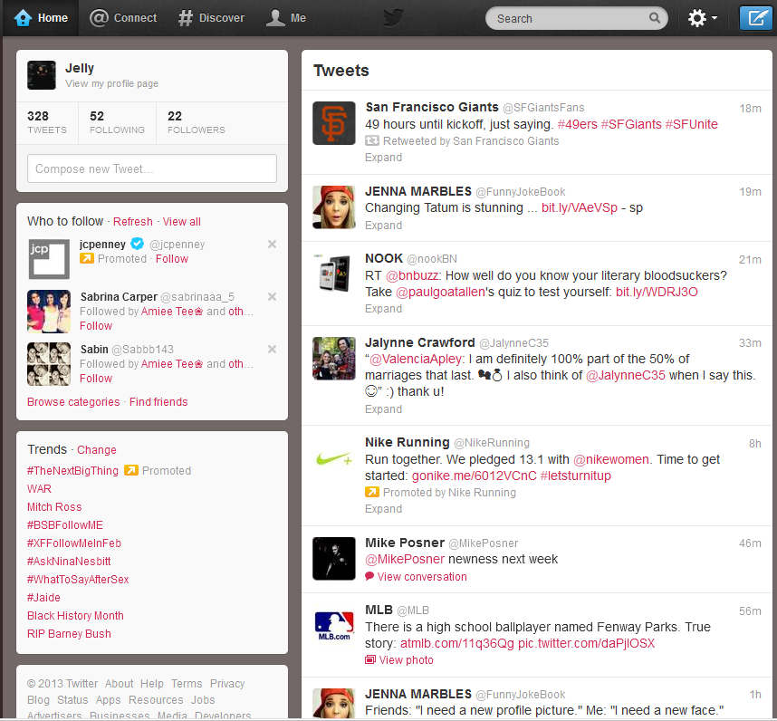
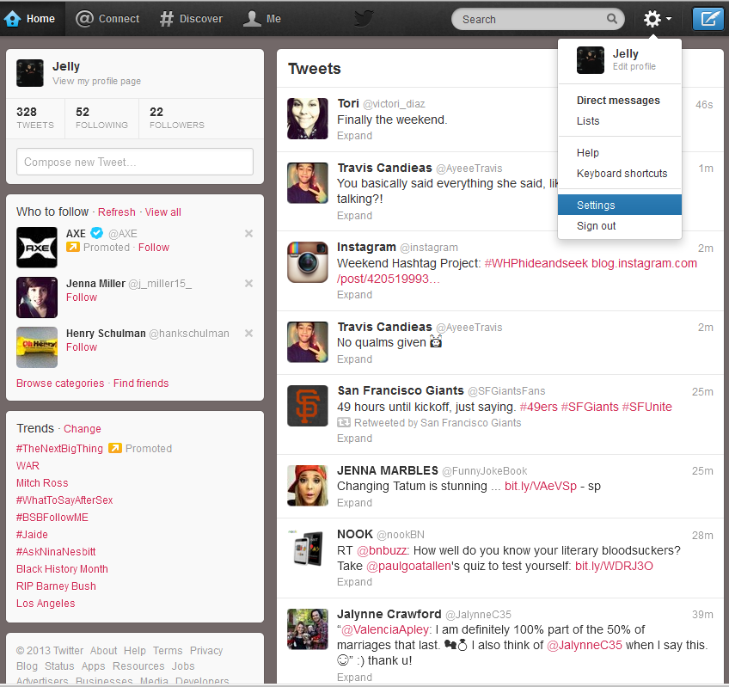
Steps to make your Twitter Private from computer
Step 1:Go to your account settings by clicking on the gear icon at the top right of the page and selecting Settings from the drop down menu.

Slide 3
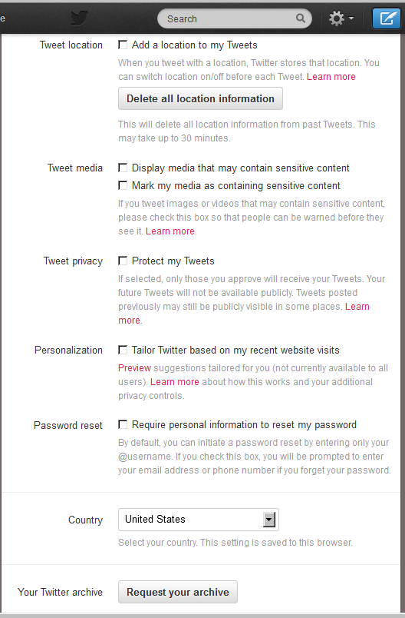
Step 2: Scroll down to the Tweet privacy section and check the box next to “Protect my Tweets”.

Slide 4
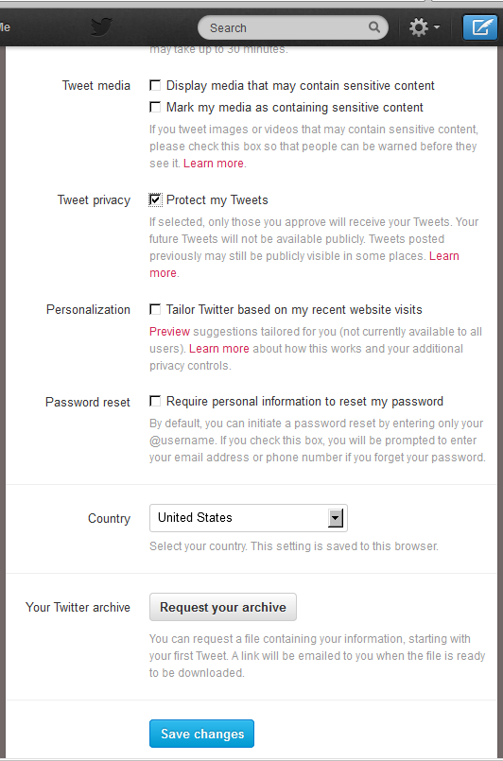
Step 3: Click the blue Save button at the bottom of the page. You will be prompted to enter your password to confirm the change.
Don’t forget to save your changes!

Slide 5

Step 1: Go to your profile and click on ME (Profile) and then click on the icon on the left hand side.
How to change your profile to private from your mobile phone
2
1

Slide 6
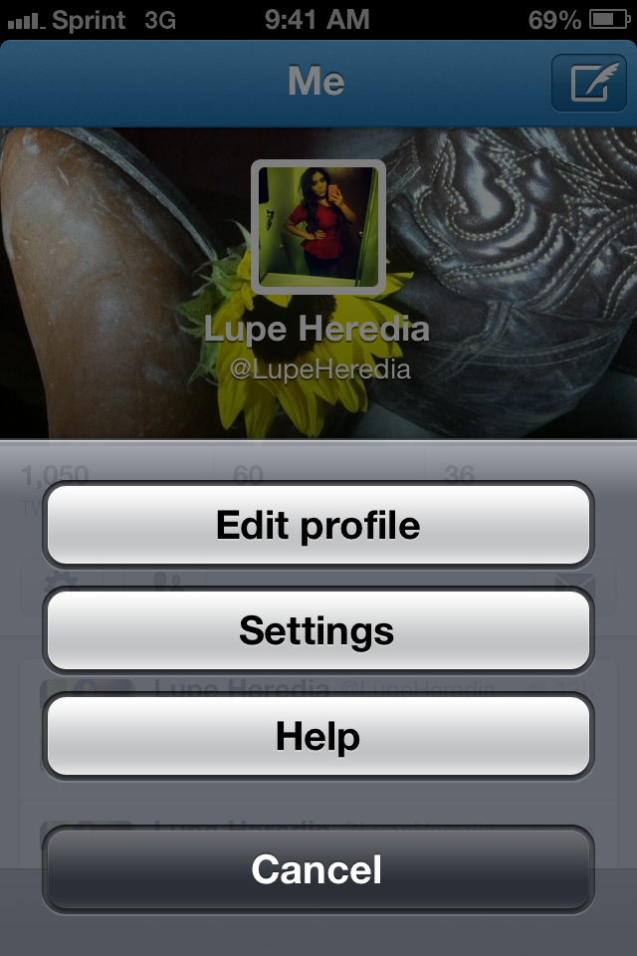
Step 2: Click on Settings from the drop menu.

Slide 7
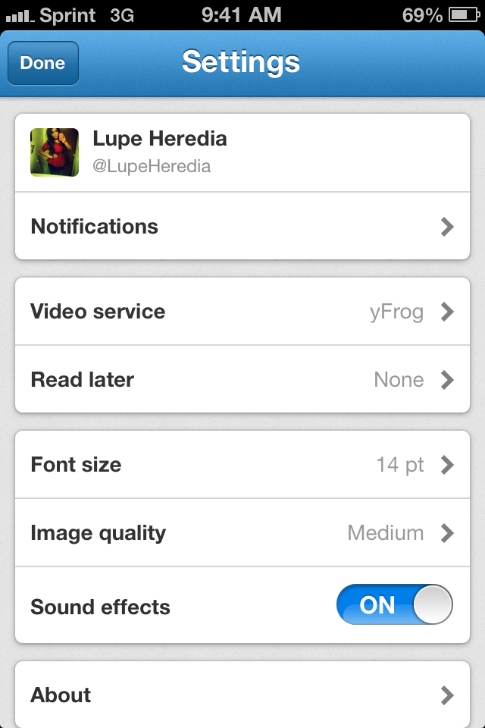
Step 3: Click on About

Slide 8
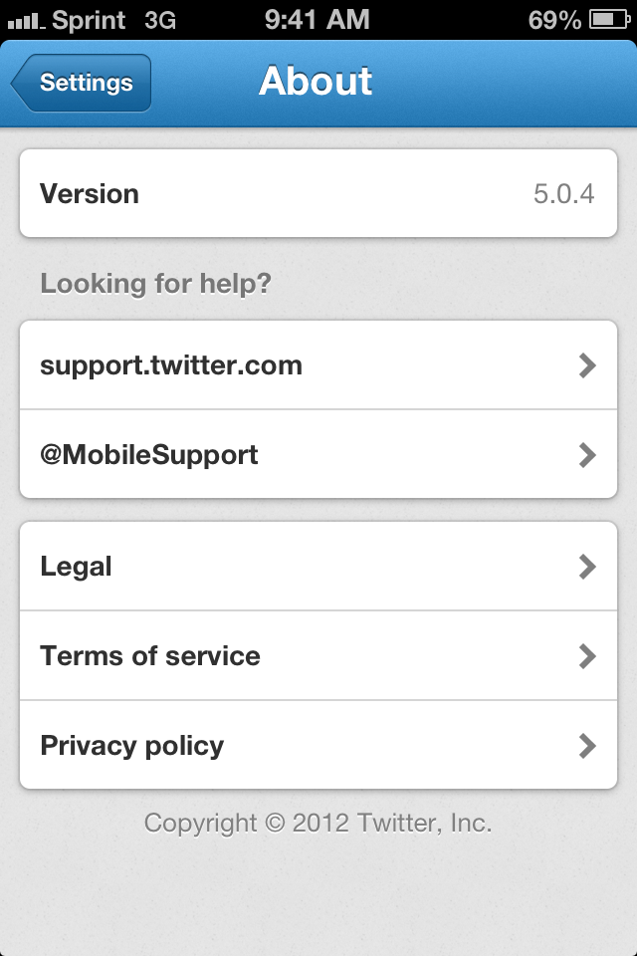
Step 4: Scroll down and click on Private Policy.

Slide 9
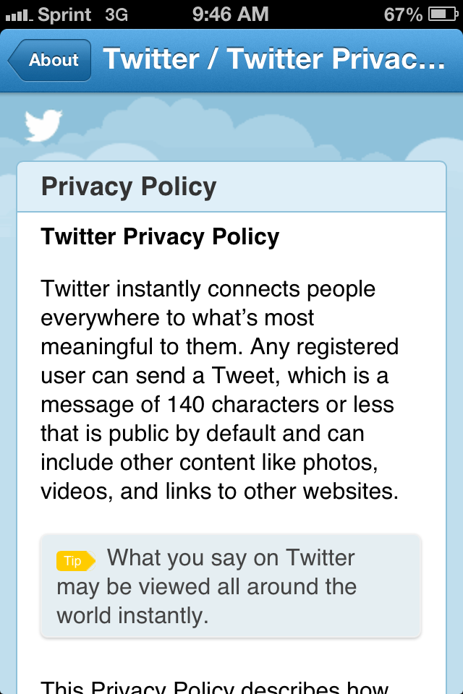
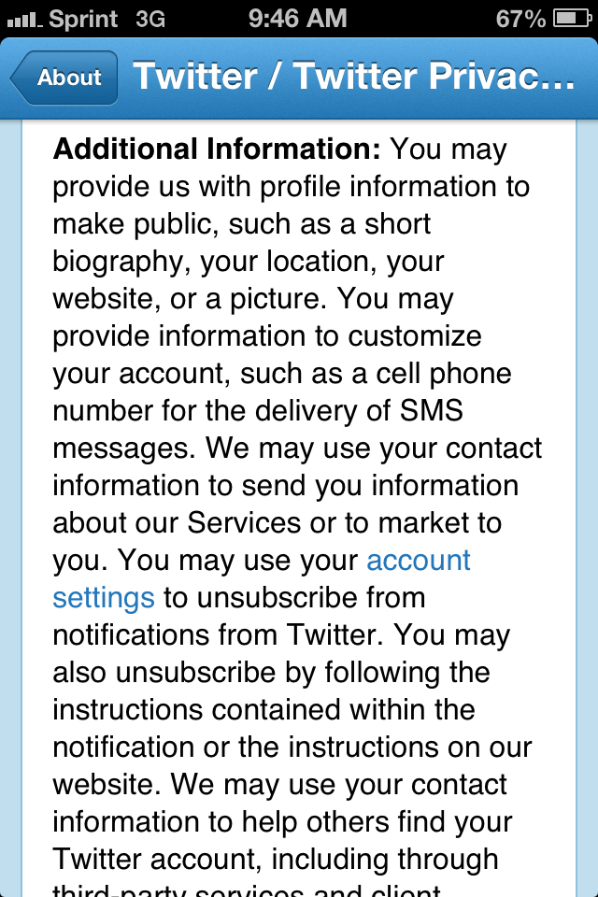
Step 5: Scroll down (left) and click highlighted Account Settings (right).
SCROLL DOWN

Slide 10
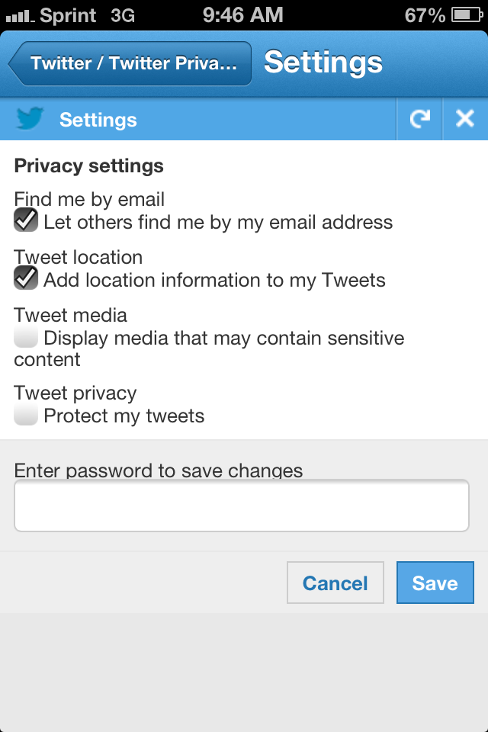
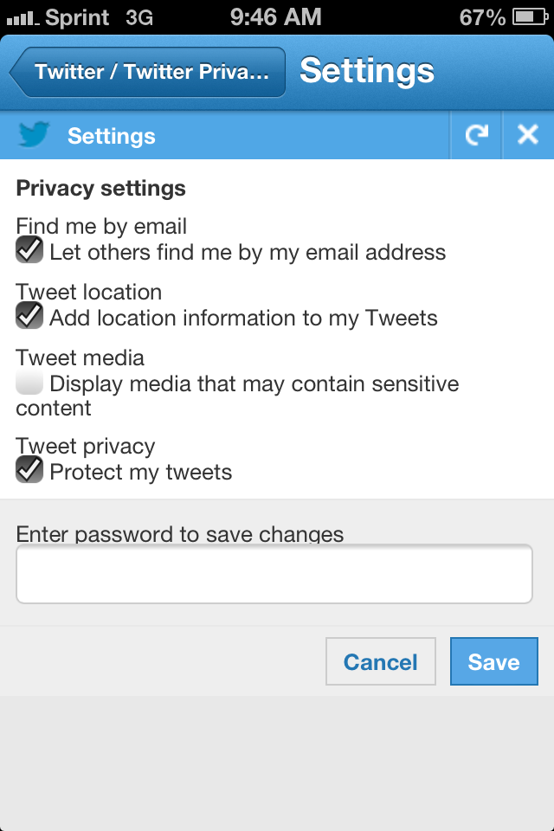
Step 6: Check the box “Protect My Tweets”
TYPE IN YOUR PASSWORD TO CONFIRM CHANGES.
REMEMBER TO SAVE!!

Slide 11
Reporting a problem…….
Step 1: click on gear icon

Slide 12
Step 2: Click “Help” on the scroll menu

Slide 13
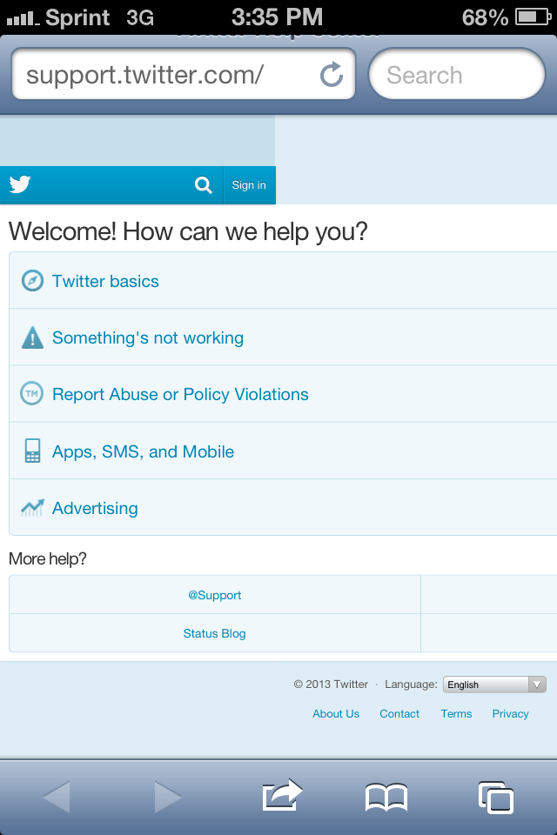
Step 3: Report……

Slide 14
How to Deactivate Twitter Account!
Step 1: click on gear icon

Slide 15
Step 2: Click “Settings” on the scroll menu

Slide 16
Step 3:Click on “About”

Slide 17
Step 4: Click on “Terms of service”

Slide 18
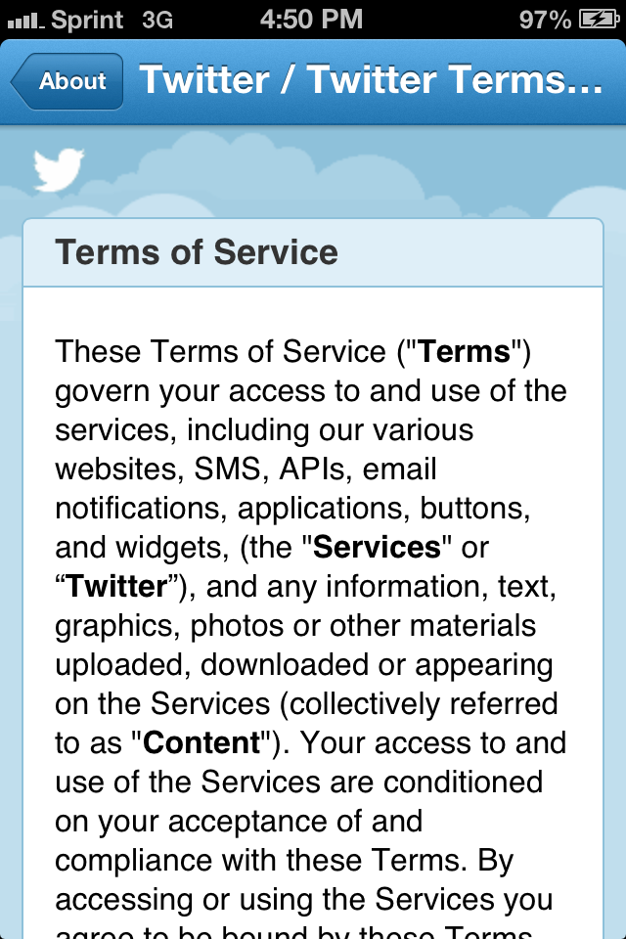
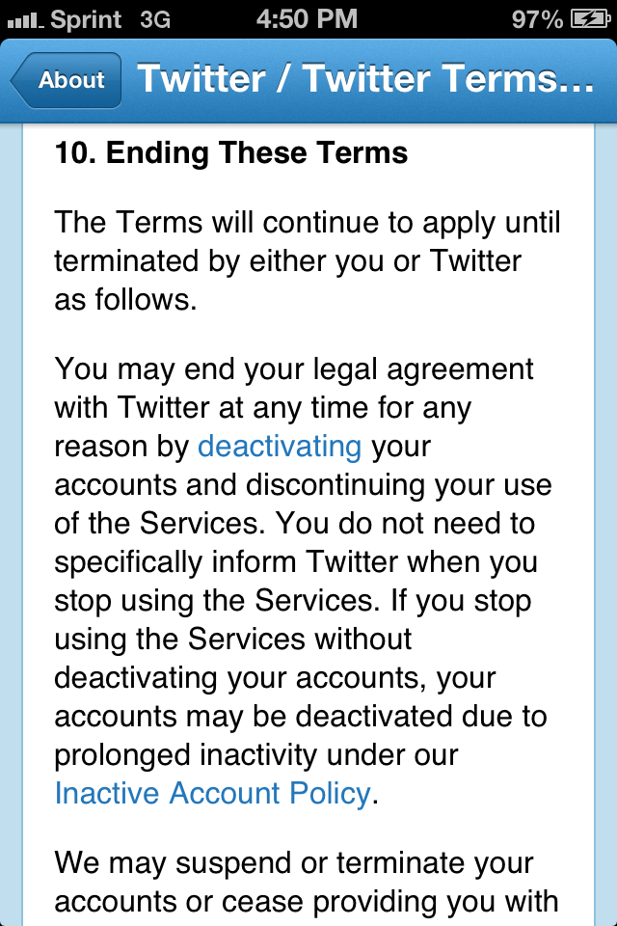
Step 5: Scroll Down to “10.Ending These Terms” (left) and Click on “Deactivating” Link (right)!
Scroll Down

